Slide 1
Quantum Computing Architectures (EE274) Lecture 24
Hiu-Yung Wong
apr. 24, 2025
hiuyung.wong@sjsu.edu, Office: ENG363
http://www.sjsu.edu/people/hiuyung.wong/index.html

Slide 2
Outline
Charge Qubit
1-qubit gate and 2-qubit gate
Transmon

Slide 3
Announcement

Slide 4
Cooper Pair Box Coupled to a Voltage Source and Circuit Quanitzation
Chapter 17 of “Quantum Computing Architecture and Hardware for Engineers: Step by Step”

Slide 5
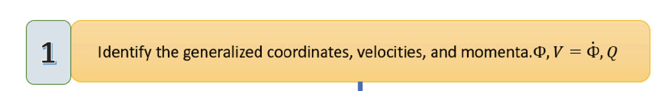
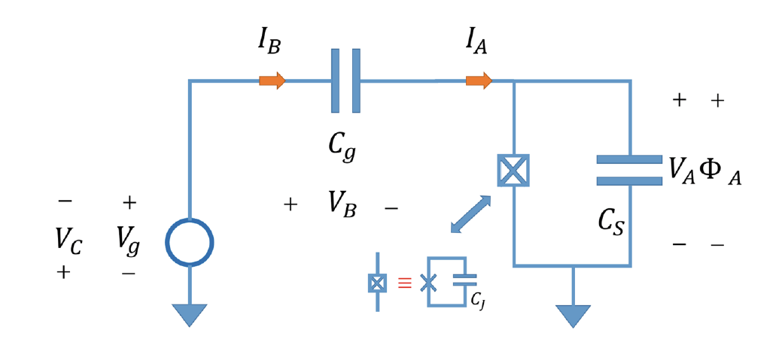
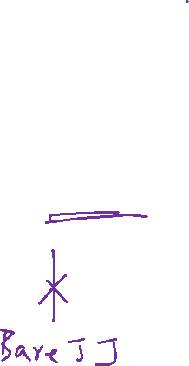
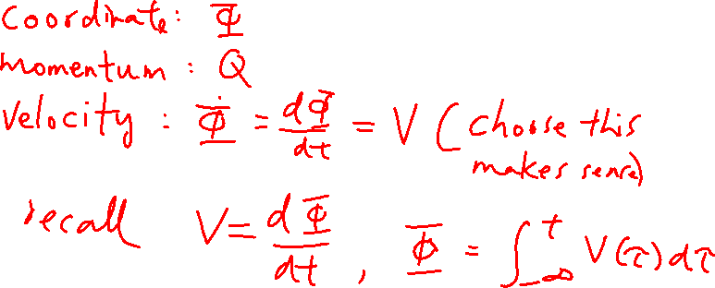
Cooper Pair Box Coupled to an Voltage Source and Quantization
From the last lecture

Slide 6

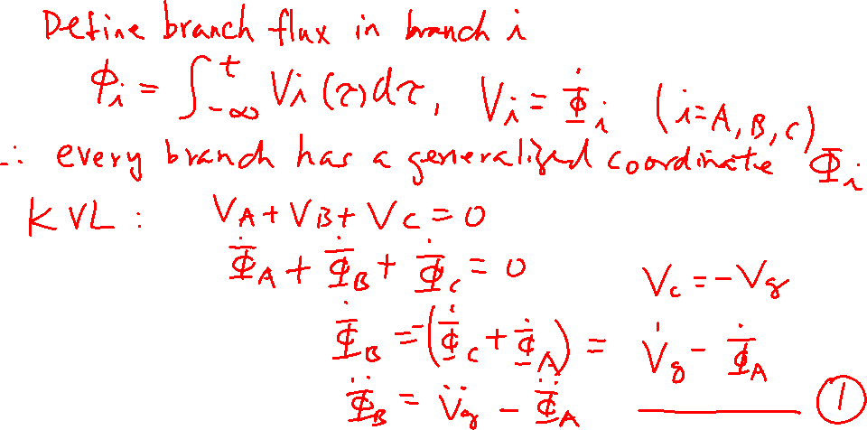
Cooper Pair Box Coupled to an Voltage Source and Quantization
From the last lecture

Slide 7
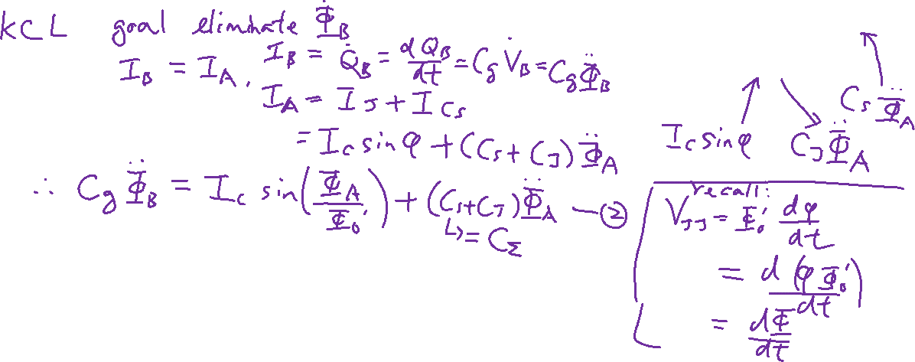
Cooper Pair Box Coupled to an Voltage Source and Quantization

Slide 8
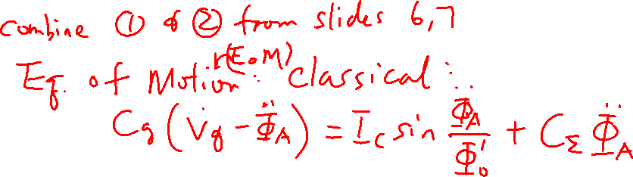
Cooper Pair Box Coupled to an Voltage Source and Quantization

Slide 9
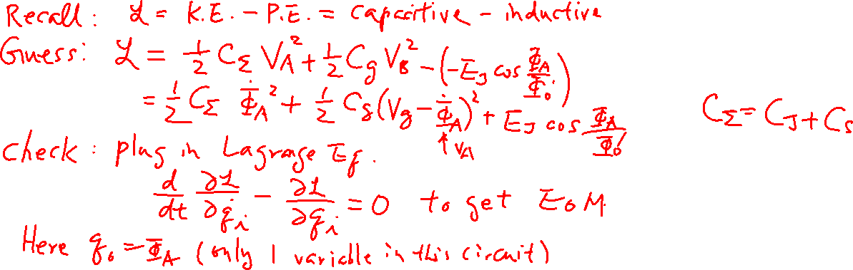
Cooper Pair Box Coupled to an Voltage Source and Quantization

Slide 10
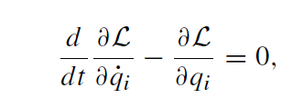
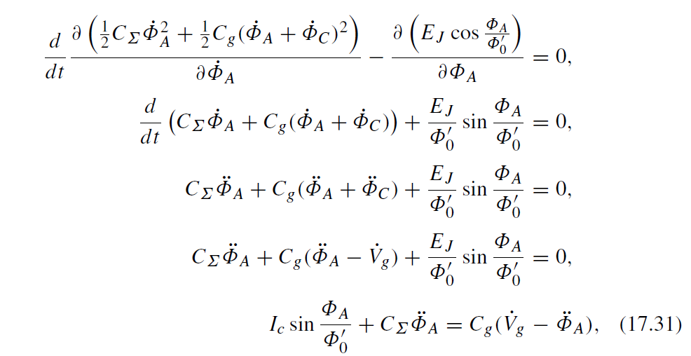
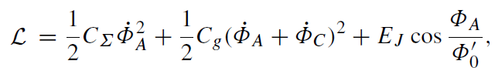
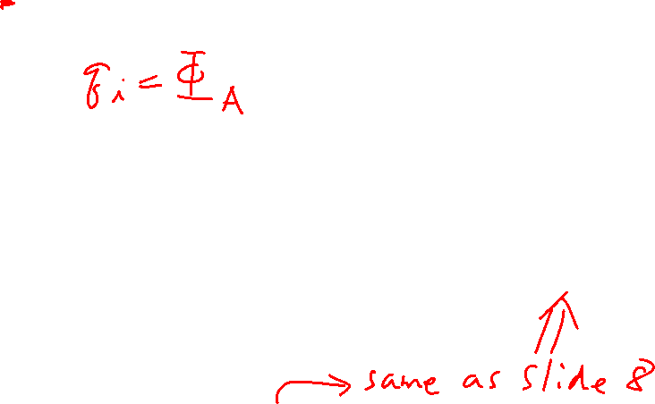
Cooper Pair Box Coupled to an Voltage Source and Quantization
Check:
Correct EoM!

Slide 11

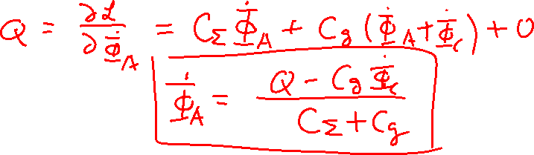
Cooper Pair Box Coupled to an Voltage Source and Quantization

Slide 12
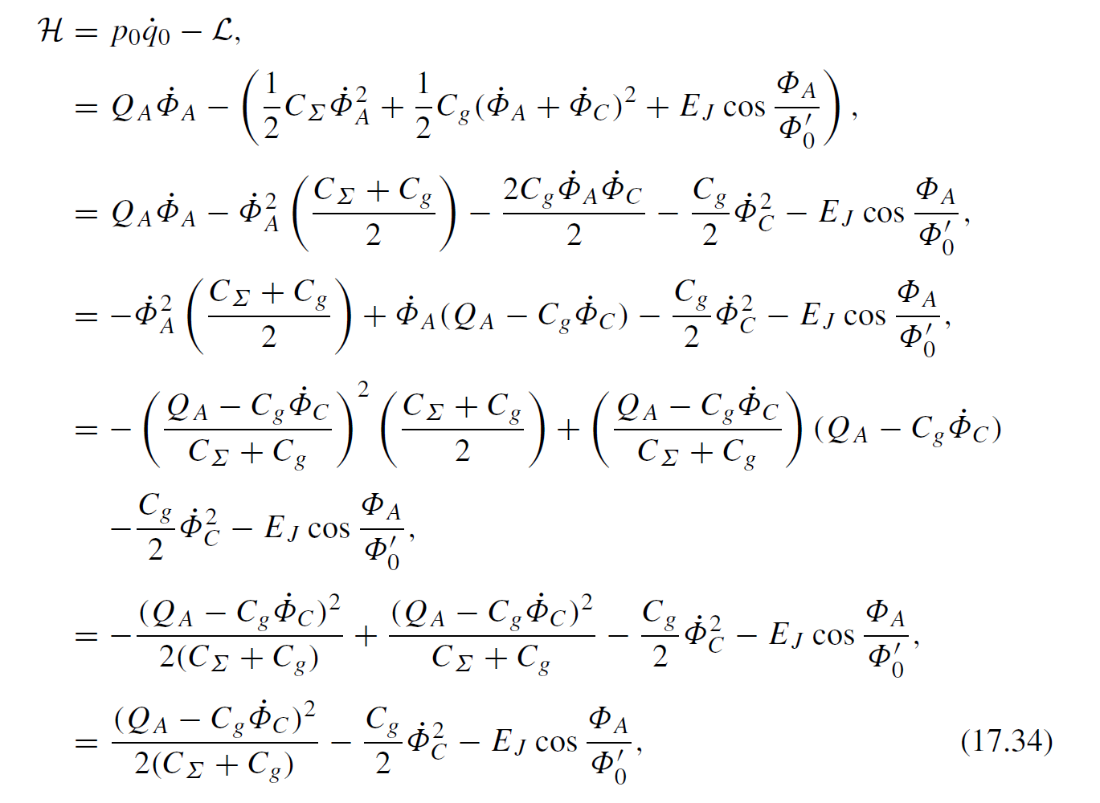
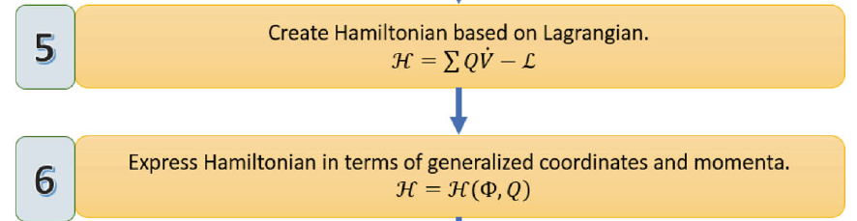
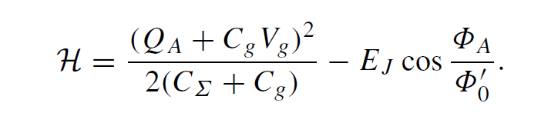
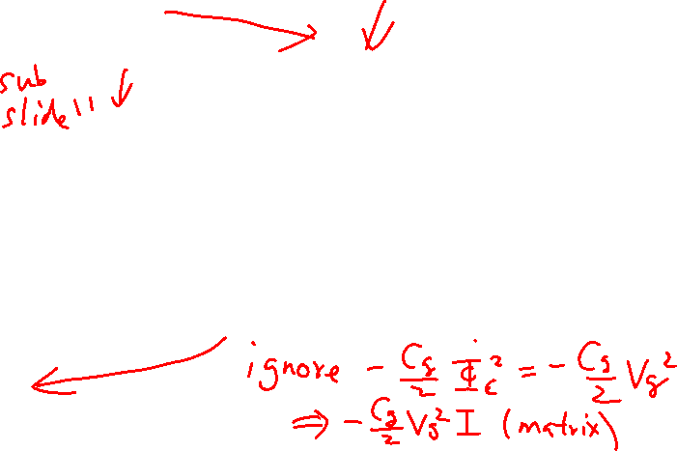
Cooper Pair Box Coupled to an Voltage Source and Quantization
Final Hamiltonian:

Slide 13
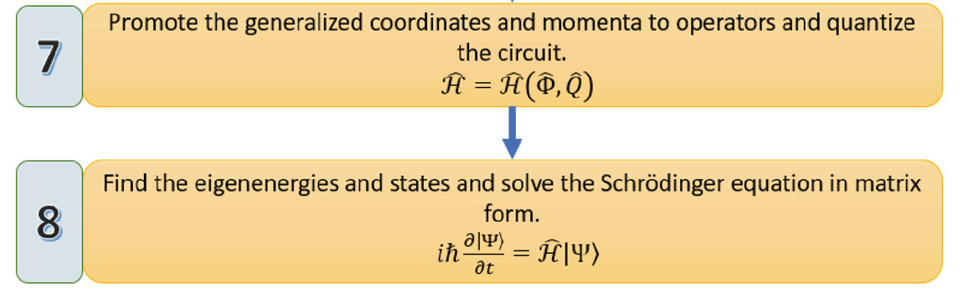
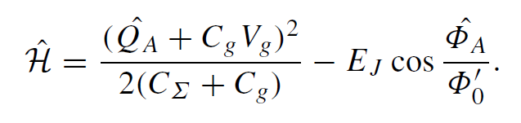
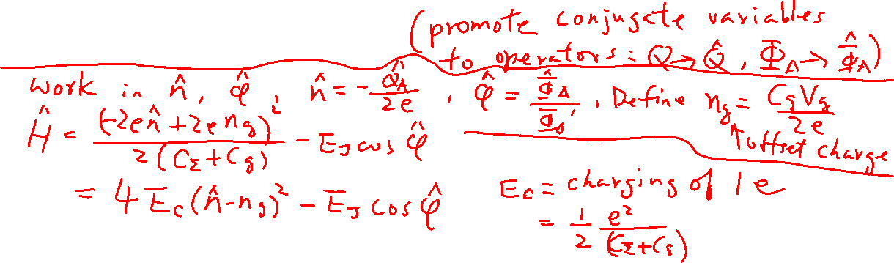
Cooper Pair Box Coupled to an Voltage Source and Quantization

Slide 14
Analytical Solution for Cooper Pair Box
Chapter 18 of “Quantum Computing Architecture and Hardware for Engineers: Step by Step”

Slide 15

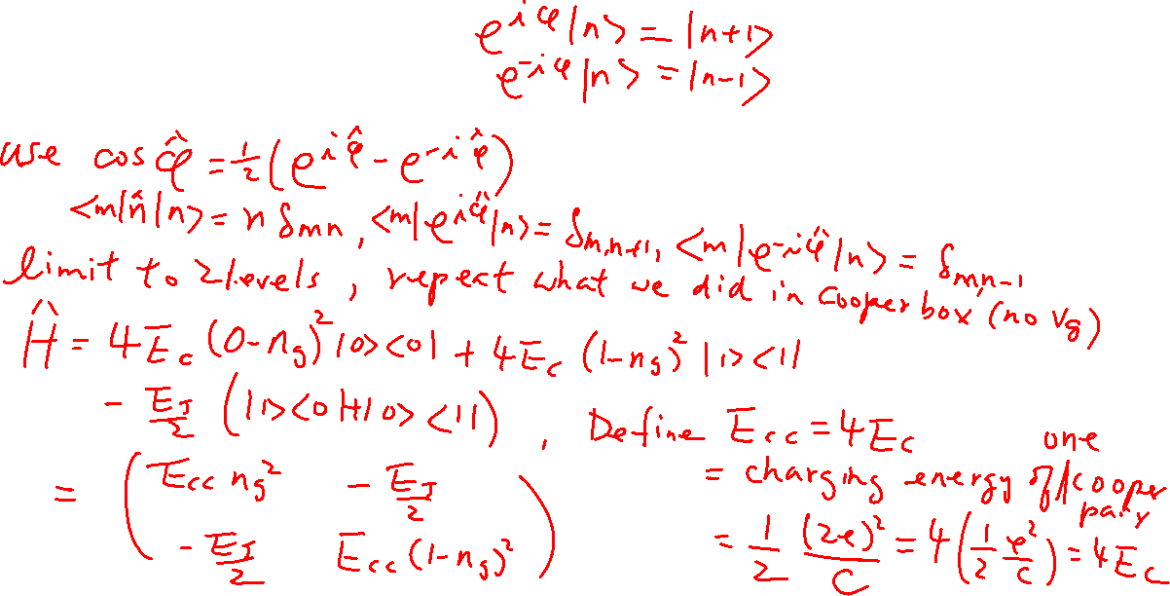
Hamiltonian of a Cooper-Pair Box with 2-level Approximation

Slide 16
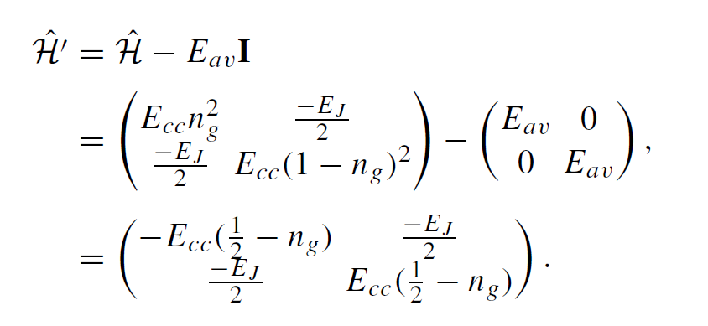
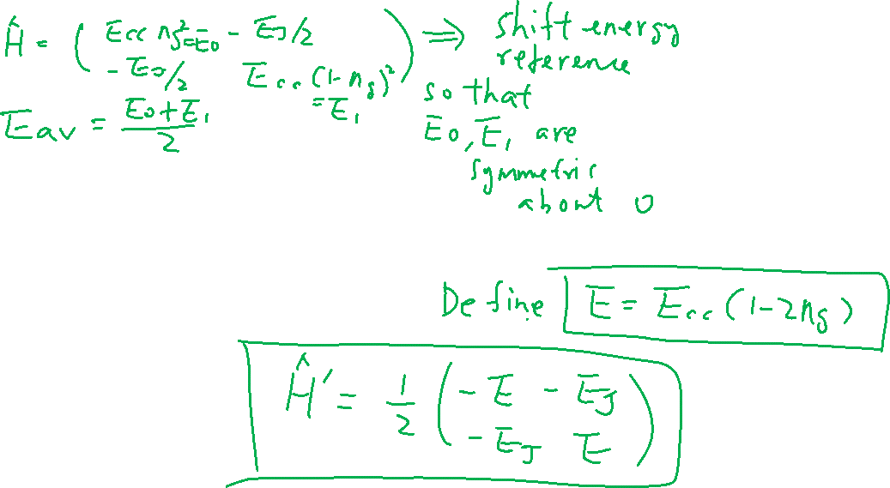
Hamiltonian of a Cooper-Pair Box with 2-level Approximation

Slide 17
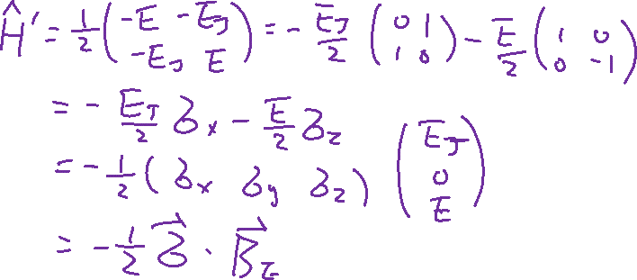
Solution of a Cooper-Pair Box with 2-level Approximation

Slide 18
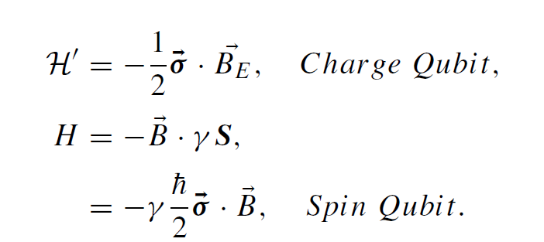
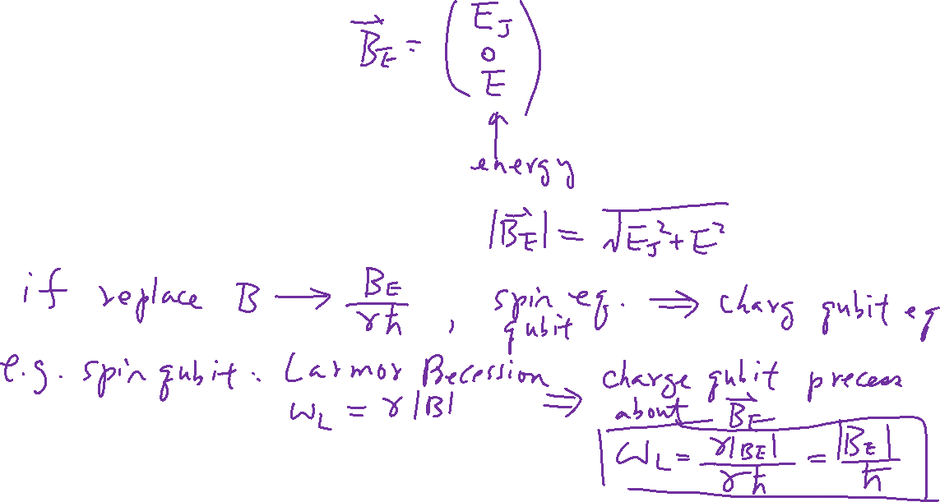
Solution of a Cooper-Pair Box with 2-level Approximation

